Slide 1

C O T I V I T I
Clinical Natural Language
Technology for Health Care
NLP · OCR · Computer Vision · LLM · LMM
Shrihan Anikapati
ECE Honors & Mathematics · Finance Minor | The University of Texas at Austin
Cotiviti Intern Assessment · 2026
Notes:
Hi, my name is Shrihan Anikapati, and I’m an Electrical and Computer Engineering Honors and Mathematics student at The University of Texas at Austin. I’m also pursuing a minor in Finance, and over time I’ve become especially interested in the intersection of AI, applied software engineering, and data-driven decision systems — especially when those technologies create measurable business value and improve real operational workflows.
For this project, the topic I chose was Clinical Natural Language Technology for Health Care, with a focus on NLP, OCR, computer vision, large language models, and large multimodal models. My written report explains the strategic opportunity, and my proof of concept demonstrates it in a working application.
The tool I built is called the Clinical Report AI Assistant. I designed the interface with a Cotiviti-inspired visual theme, using purple accents, clean dashboard cards, and consistent status messages so the prototype feels aligned with Cotiviti’s brand while still being simple and reviewer-friendly. The tool reviews unstructured clinical documentation, summarizes the note, extracts clinical entities, identifies documentation gaps, and allows a reviewer to ask targeted questions.
The main idea is simple: AI should not replace clinical, coding, or payment integrity judgment. It should prepare better information for expert reviewers, help them move faster, and support more consistent decisions.

Slide 2




Why Cotiviti?
About Me
The opportunity to use data, analytics, and technology to improve healthcare accuracy, efficiency, and trust.
ECE Honors + Mathematics
Statistical reasoning, model reliability, systems thinking
Operates where data quality directly affects both patient outcomes AND financial integrity. Most companies optimize for one.
Finance Minor
ROI framing, risk exposure, competitive positioning
Responsible AI philosophy: AI amplifies expert judgment, never replaces it. Confirmed in Cotiviti's CCC25 leadership content.
Builder Mindset
I shipped a working POC for this assessment, not just a slide
Post-Visit Review already deploys the NLT stack I researched. This isn't hypothetical for Cotiviti, it's core business.
Healthcare AI Focus
Applied AI where data quality has real human consequences
#1 highest-designated leader, Everest Group Payment Integrity PEAK Matrix 2025. Market recognizes the differentiation.
Notes:
I structured the project around Cotiviti’s mission and business context.
Cotiviti enables healthcare organizations to improve performance through advanced technology, data analytics, payment accuracy, risk adjustment, and more.
That makes clinical documentation intelligence a strong fit, because documentation quality affects both patient care and financial accuracy.
A clinical note can influence a wide range of things like coding accuracy, risk adjustment, claims review, quality measurement, and operational decisions.
So my goal wasn’t to build a generic AI chatbot. My goal was to build a reviewer-centered AI assistant that reflects the type of workflow Cotiviti could actually use or expand on.

Slide 3




What Is Clinical NLT?
A stack of technologies that lets machines read, interpret, and act on clinical language. Each layer solving a different part of the problem.
NLP
OCR
CV
LLM/LMM
Parses physician notes, extracts diagnoses, handles negations ("no history of diabetes" vs "history of diabetes"), maps to ICD-10 & SNOMED CT.
Converts paper records, fax-based claims, and handwritten notes into machine-readable text. This is the prerequisite for everything above.
Extracts clinical signal from radiology images, scanned operative reports, and multi-page PDF forms alongside text.
Reasons across text + images in a single inference call. Few-shot extraction, summarization, Q&A. No task-specific retraining required.
Healthcare raises the stakes: a single misread negation in a physician note carries direct financial and compliance consequences.
Notes:
My report begins by defining clinical natural language technology.
In healthcare, valuable information is often buried in physician notes, discharge summaries, scanned records, lab reports, radiology reports, and more.
Traditional systems relied on rules and keywords. Those systems were explainable, but definitely brittle. For example, they could find the word “pneumonia,” but could struggle to understand whether the note says the patient has pneumonia, denies pneumonia, or has a past history of pneumonia.
The field then moved toward machine learning and deep learning, which improved tasks like entity recognition, classification, and clinical concept extraction.
Today, large language models and multimodal systems can summarize long documents, answer questions, extract structured information, and potentially reason across text, images, and tabular data.
But in healthcare, fluent output is not enough. The output must be accurate, auditable, privacy-safe, and useful in a real workflow.

Slide 4

Relevant Trends
Three Generational Shifts
$5.2B
Rule-based (cTAKES, MedLEE) → Transformer models (BioBERT, ClinicalBERT) → Instruction-tuned LLMs (Med-PaLM 2, BioMistral). Each shift dramatically expanded what AI can do with clinical text.
to
$16.0B
Ambient Clinical Intelligence
Voice-enabled LLMs generate EHR notes from patient-provider conversations in real time. Microsoft Dragon Copilot (Mar 2025) cut documentation burden by an estimated 40–70%. This is the fastest-growing ACI deployment to date.
25.3% CAGR · 2025–2030
NLP in Healthcare & Life Sciences
(MarketsandMarkets, 2025)
NLP in Payment Integrity (Cotiviti's Space)
AI tools now cross-reference encounter data against HCC codes at claim submission. This shows the shift from retrospective audit to prospective accuracy. Cotiviti's Post-Visit Review operationalizes this today at enterprise scale.
Notes:
The key trend I identified is the movement from simple text processing to decision-supporting documentation intelligence.
That matters because healthcare data is fragmented. A reviewer may need to understand symptoms, diagnoses, medications, lab evidence, imaging results, provider assessments, and follow-up plans across a long record.
AI can reduce the manual search burden, but only if the tool is grounded in the source documentation and keeps the reviewer in control.

Slide 5

Opportunities & Threats
OPPORTUNITIES
THREATS
Unstructured Data Value
Hallucination & Liability
~80% of healthcare data is unstructured. LLMs unlock this for HCC coding, payment accuracy, quality measurement, and population health. These are core use cases.
LLMs produce confident but factually incorrect output. In payment integrity, a fabricated audit finding carries real legal and financial consequences.
Multimodal Reasoning
HIPAA & PHI Compliance
LMMs jointly process notes, labs, and imaging in one inference call, enabling holistic documentation audits that no prior technology could support.
Routing PHI through cloud-hosted LLMs introduces significant regulatory risk, often requiring costly on-premise or private-cloud deployments.
Real-Time Coding Accuracy
Model Bias
NLP-assisted HCC and CPT validation at claim volume far exceeds manual audit team consistency, directly improving payer financial performance.
Models trained on academic center data underperform on rural or underserved populations, introducing systematic errors in risk scores and quality measures.
Interoperability via FHIR
Regulatory Uncertainty
FHIR-native NLP pipelines harmonize fragmented EHR systems. This is a capability Cotiviti significantly expanded through its 2025 Edifecs acquisition.
FDA and CMS frameworks for AI-assisted clinical coding tools are still evolving.
Notes:
For Cotiviti, I saw three to four major opportunities.
First is unstructured data value. If clinical notes and PDFs contain information that is not captured cleanly in structured fields, NLP can unlock that information for payment accuracy, quality measurement, and risk adjustment.
Second is documentation gap detection. AI can help flag missing specificity, unclear evidence, missing dosage details, or vague follow-up instructions before those issues create downstream friction.
Third is operational efficiency. A reviewer can start with a summary and prioritized questions instead of manually reading every line from scratch. The threats are just as important.
Large language models can hallucinate. They can sound confident while being unsupported by the record. They can miss clinical nuance, reflect bias, or create compliance risk if protected health information is handled incorrectly.

Slide 6


Strategic Recommendations for Cotiviti
Two investments extending Cotiviti's existing advantage:
01 | Fine-Tuned Clinical LLM for Prospective Documentation Gap Detection
Fine-tune a domain-specific LLM on Cotiviti's proprietary corpus of encounter data, HCC coding outcomes, and audit decisions. This model identifies documentation gaps at claim submission, shifting the value proposition from retrospective audit to prospective accuracy. The Edifecs FHIR pipeline provides the data infrastructure. No competitor without Cotiviti's data depth could replicate this product.
02 | Responsible AI Framework as a Market Differentiator
Cotiviti's leadership stated at CCC25 that AI should amplify expert judgment, not replace it. Formalizing this as a published Responsible Clinical AI framework - covering model explainability, clinician review checkpoints, bias monitoring across patient subgroups, and audit trails - directly addresses health plans' growing liability concerns. In a market crowded with AI vendors making broad promises, this makes Cotiviti the trusted choice and reinforces its values: transparency, authenticity, and accountability.
Notes:
That is why my recommendation is not autonomous decision-making.
My recommendation is a human-in-the-loop clinical intelligence layer: AI surfaces relevant information, and the expert reviewer makes the final judgment.
My strategic recommendation for Cotiviti is to continue investing in clinically focused LLM workflows that combine summarization, entity extraction, documentation gap detection, and question answering.
I also recommend positioning responsible AI as a differentiator.
Cotiviti emphasizes trust, transparency, accountability, and healthcare performance. A strong AI product should reflect those same values by being explainable, reviewable, and connected to measurable client value.

Slide 7


Proof of Concept: Clinical Report AI Assistant
A working Streamlit app that demonstrates the exact documentation-quality problem Cotiviti's Post-Visit Review solves at enterprise scale
Clinical Summary
Entity Extraction
Documentation Gaps
Clinical Q&A
Gemini 2.5 Flash Lite summarizes any pasted or uploaded clinical note into structured bullet points covering presenting issue, history, tests, treatment, and plan.
Extracts diagnoses, symptoms, labs, medications, imaging, providers, and time references from free text into a clean structured table.
Flags missing dosages, ambiguous wording, absent test values, vague follow-up timing, and missing allergy documentation. This is exactly what coders and reviewers need.
Answer any question about the note, grounded in the source document only. Next step: citations back to exact source lines for full auditability.
Tech Stack:
Python
Streamlit
Gemini 2.5 Flash
PyPDF
Pandas
Demo Mode
Notes:
Now I’ll switch from the report to the proof of concept.
The report explains the strategic opportunity. The POC demonstrates the core capability.
This is the Clinical Report AI Assistant. The interface is minimalistic and right to the point.
On the left side, I show the product framing, the core features, and the tech stack: Python, Streamlit, CSS, Google Gemini API, PyPDF, and pandas.

Slide 8
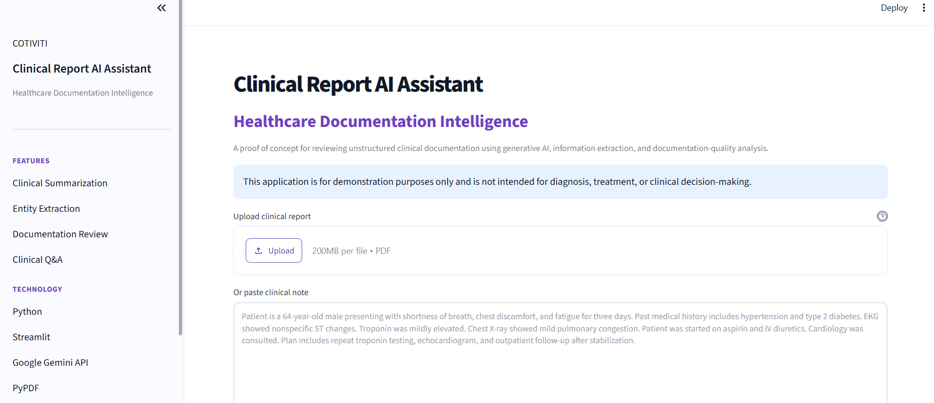
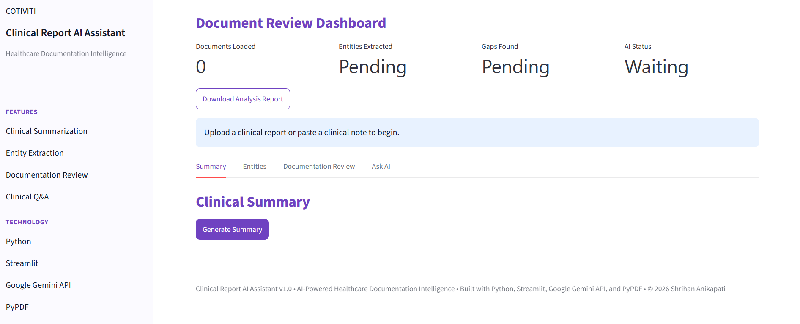
POC Demo — Live Interface
Upload PDF or paste clinical note and the text is extracted automatically
Real-time dashboard: Documents Loaded · Entities · Gaps · AI Status
Notes:
I’m going to upload a sample clinical report now.
The app extracts text from the PDF, or a reviewer can paste a clinical note directly.
Once the note changes, the app clears previous outputs. That is an important safety detail. In healthcare, stale results from a previous document would be unacceptable, so the app resets the summary, entity table, documentation review, and Q&A whenever the input changes.
Now the dashboard shows the document is ready.
It tracks whether a document is loaded, whether entities have been extracted, whether documentation review is complete, and whether the AI is ready.
This is small, but it reflects workflow design: reviewers need to know what has been completed and what is still pending.

Slide 9
Demo Summary
Each tab solves a different reviewer problem — the same problems Cotiviti's clients face at enterprise scale
01
Generate Summary
Faster chart review for risk adjustment and quality teams.
Paste or upload the clinical note. One click generates a structured bullet summary: presenting issue, PMH, tests, treatments, plan. Orients the reviewer in seconds vs. reading the full document.
02
Extract Entities
Connects to HCC logic, CPT validation, and quality measures.
Structured table: conditions, symptoms, labs/tests, imaging, medications, provider, time references. Turns free text into machine-comparable facts.
03
Documentation Review
Human-in-the-loop: AI surfaces gaps, reviewer decides.
Flags missing dosages, absent test values, vague follow-up, unclear allergy status, missing final assessment. Returns reviewer follow-up questions.
04
Ask AI
Auditable AI: every answer traceable to a source document.
Grounded Q&A from the source document only. Answers stay within the clinical note, so hallucination is structurally limited. Next step: citations back to exact source lines.
Notes:
6:35–9:35 — Use this slide as your cue card. Walk through each step in order, calling out the business value on the right side of each card. Show reviewers that every feature has a real Cotiviti use case attached to it.

Slide 10
C O T I V I T I
Thank You
Key Takeaways
Clinical NLT is a $16B market growing at 25% CAGR, and Cotiviti is already at the center of its most valuable application: payment integrity and risk adjustment.
Two strategic investments: a fine-tuned clinical LLM and a published responsible AI framework, both extending what Cotiviti already does.
My POC demonstrates the documentation-gap detection capability at the prototype level.
ECE Honors + Mathematics + Finance Minor: I build the systems, understand the statistics, and frame the business value. Ready to contribute from day one.
Shrihan Anikapati · UT Austin · shri.anikapati@gmail.com · Cotiviti Intern Assessment 2026
Notes:
To close, my report and POC both point to the same conclusion: Cotiviti can use clinical natural language technology not as a replacement for expertise, but as infrastructure that makes expert review faster, more consistent, and more scalable.
This project reflects the kind of intern I want to be: technical enough to build, analytical enough to understand the business value, and responsible enough to know that in healthcare, the goal is not just automation.
The goal is better, more trustworthy decisions.
Thank you for reviewing my submission.

